Slide 1

Customer Complaint Triage and Response
Nicholas Stirling
Bellevue University
DSC670-T301 Advanced Uses of Generative AI (2265-1)
Professor Frank Neugebauer

Slide 2
Objective
Customer complaints represent a valuable source of operational and compliance information.
This application seeks to increase efficiency of complaints servicing by:
Enhancing consistency with standardized policy-aligned responses.
Support early identification, triage, and classification.
Improve customer experience with faster, more coherent responses.

Slide 3
Methods
Publicly available synthetic complaint datasets containing structured and unstructured fields were used to train a fine tuned OpenAI model.
This fine tune model will take an unstructured text complaint and output:
Complaint category and sub-category
Complaint summary
Generate an initial response

Slide 4
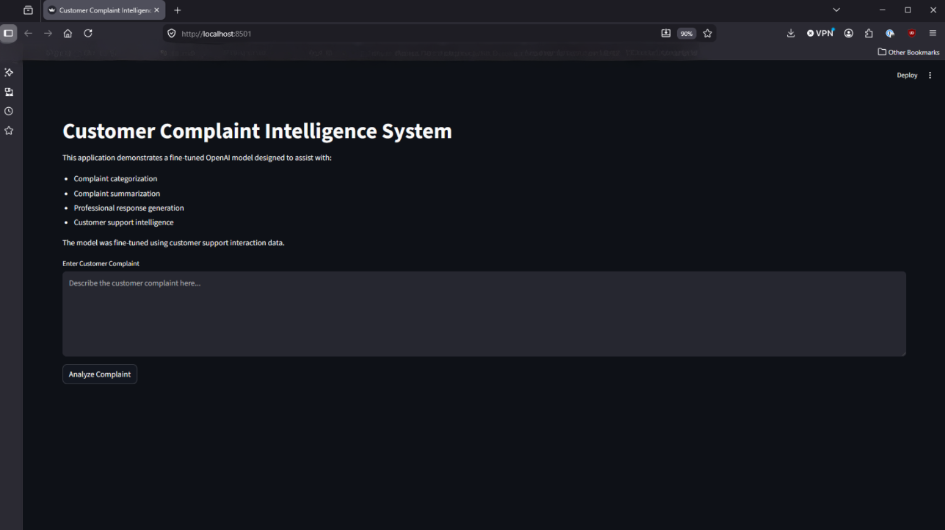
Home screen

Slide 5
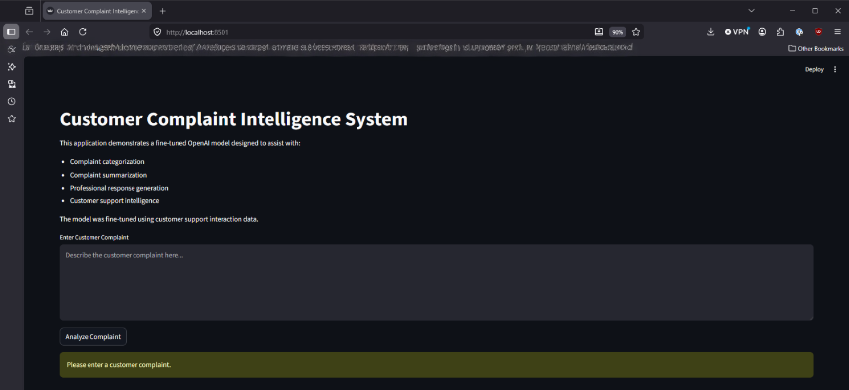
Error Handling

Slide 6
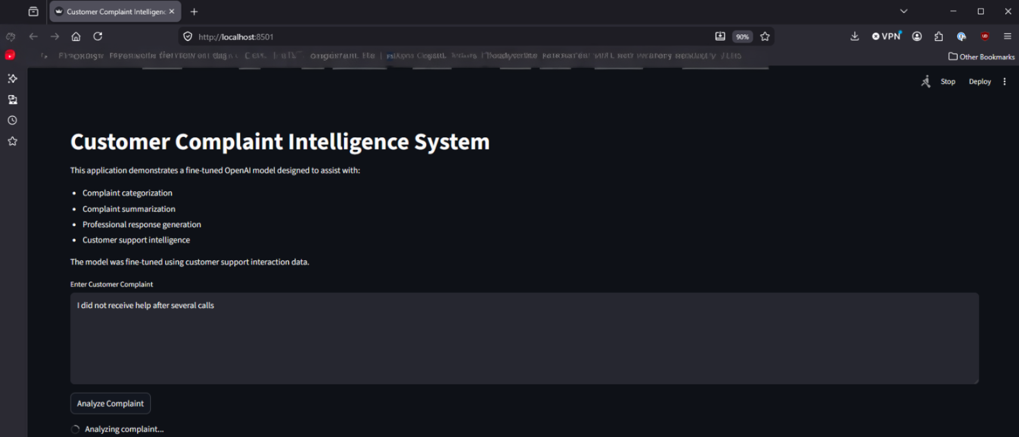
Request Processing

Slide 7
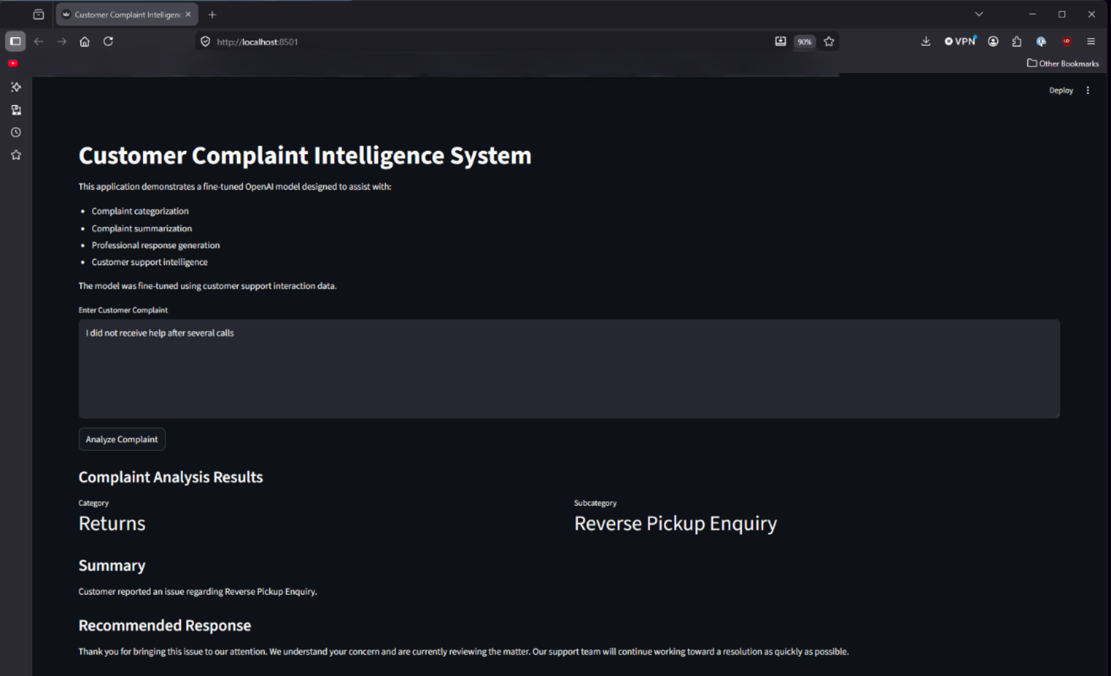
Results Example 1

Slide 8
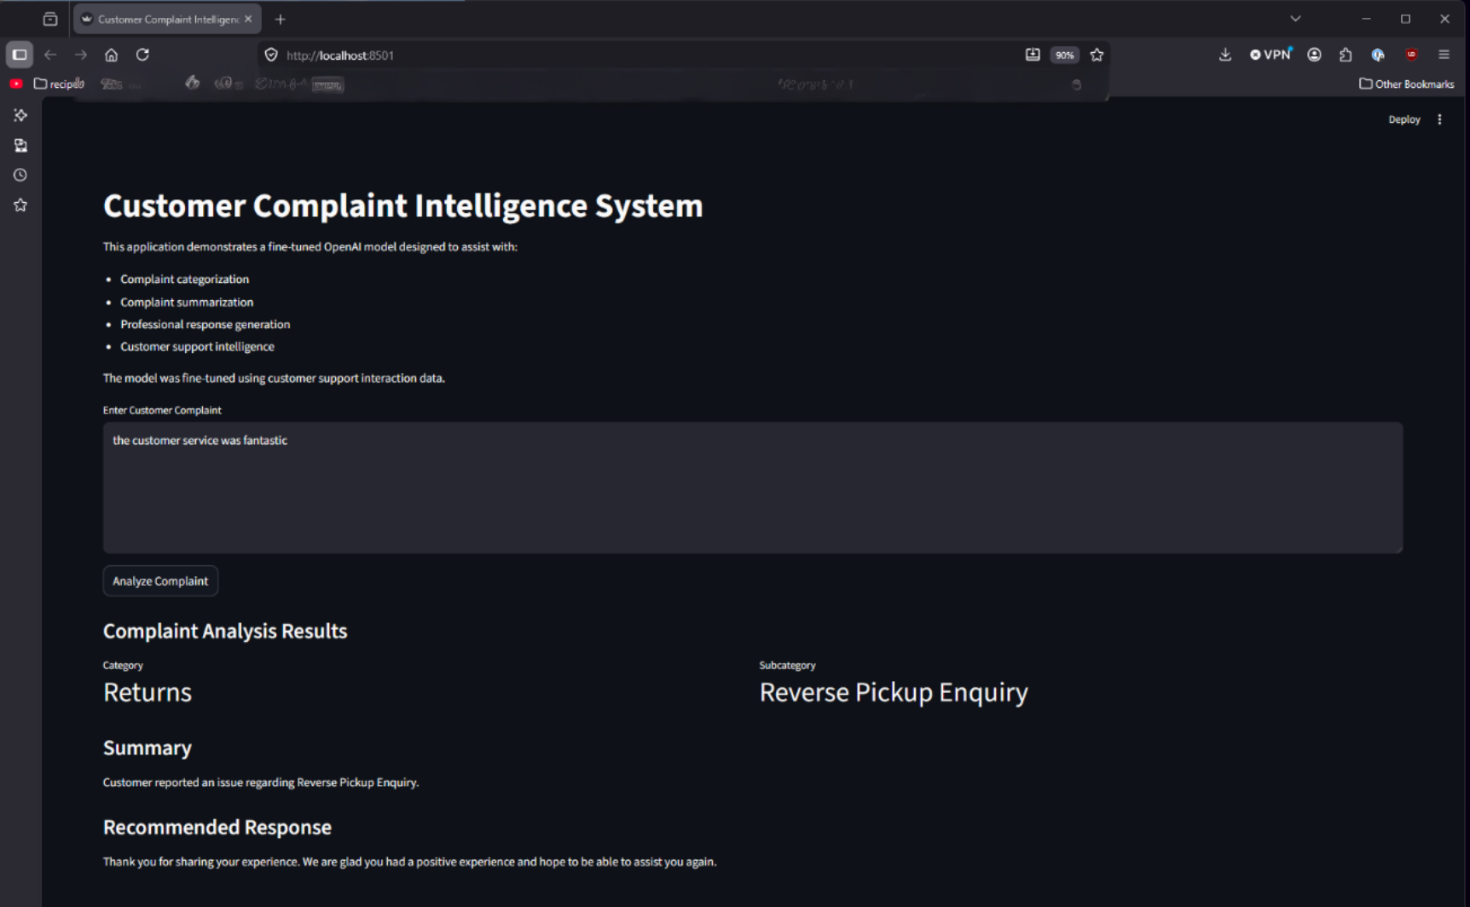
Results Example 2

Slide 9
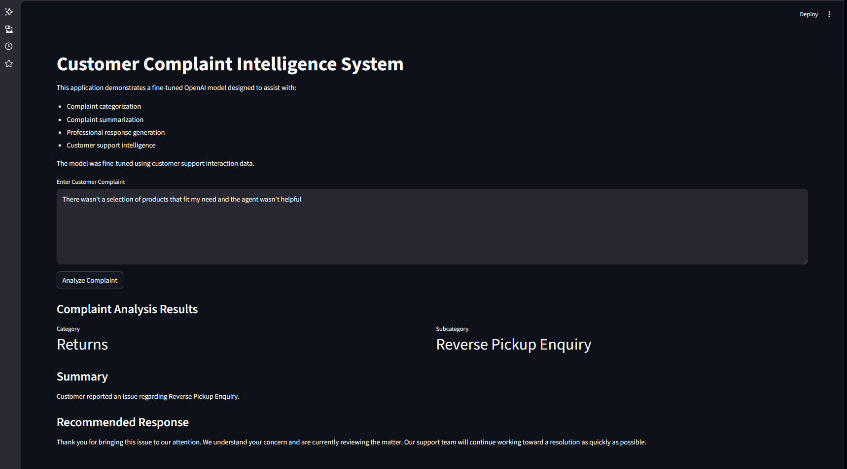
Results Example 3

Slide 10
Next Steps
Integration into historical organization complaint data and responses to refine fine-tuned model
Testing for alignment with organizational categories and policy aligned responses
Safeguard implementation to reduce risk of ineffective customer interaction
Continuous monitoring and adjustment for potential drift

